Slide 1
Dan Birman
2016-02-16
Frisem

Slide 2
What is it like to be a monkey?

Slide 3
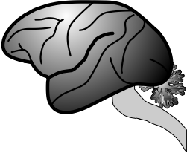
What is it like to be a monkey?

Slide 4
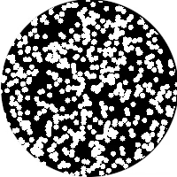
What is it like to be a monkey?

Slide 5
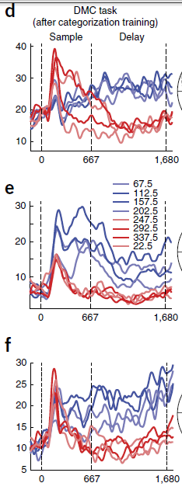
What is it like to be a monkey?

Slide 6
What is it like to be a monkey?

Slide 7
What is it like to be a monkey?

Slide 8
What is it like to be a monkey?
prospective student

Slide 9
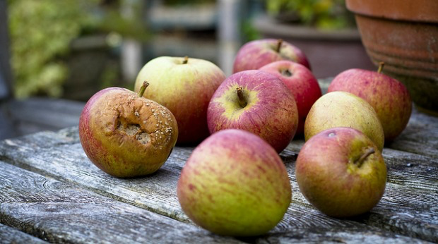

Slide 10
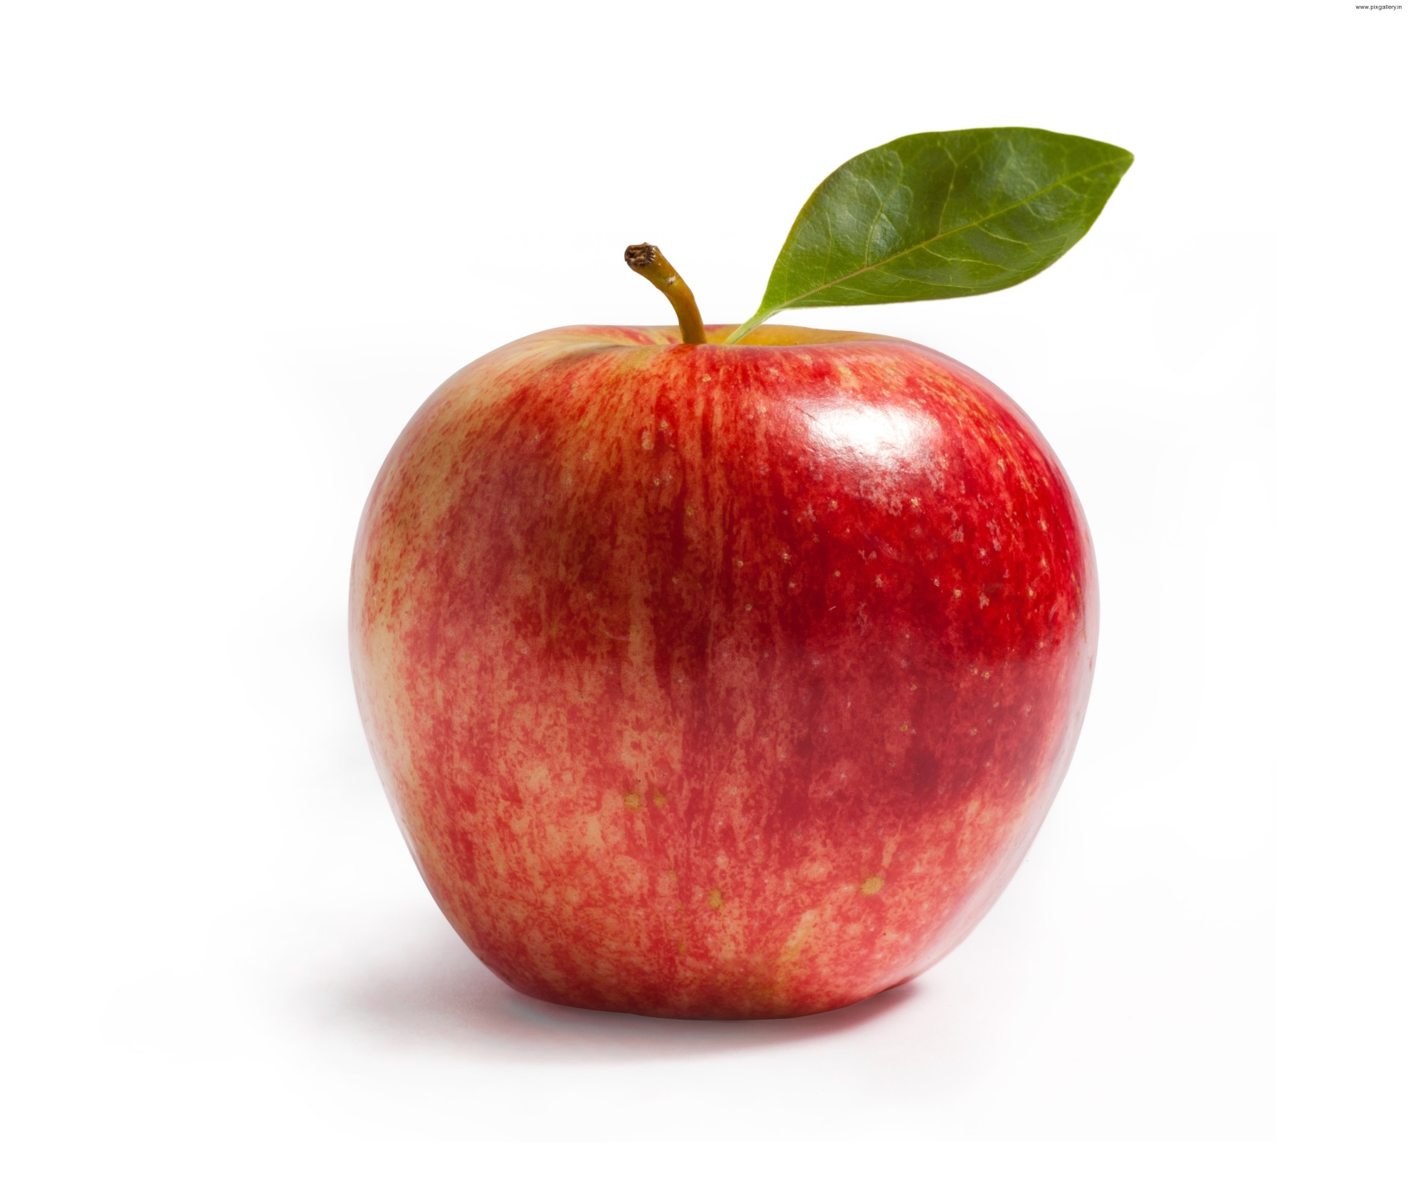

Slide 11
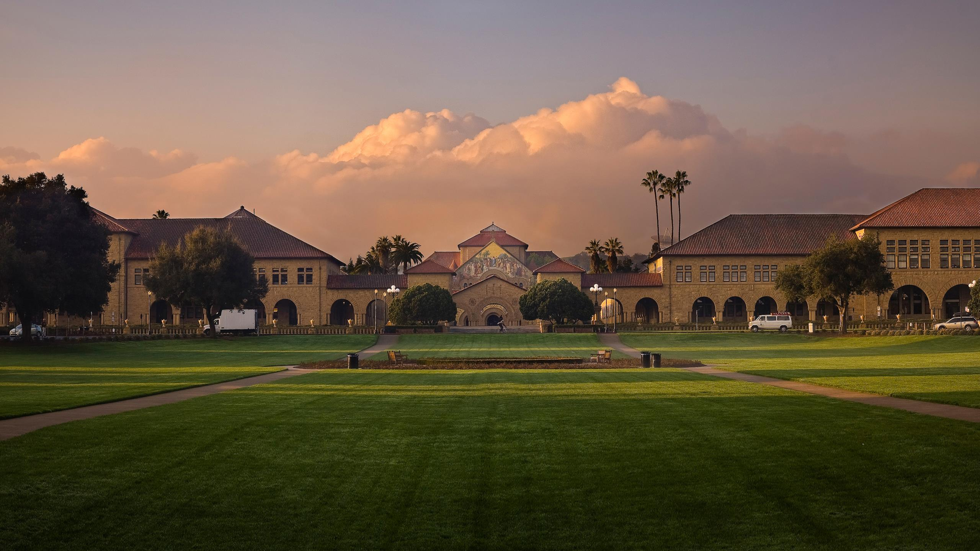

Slide 12
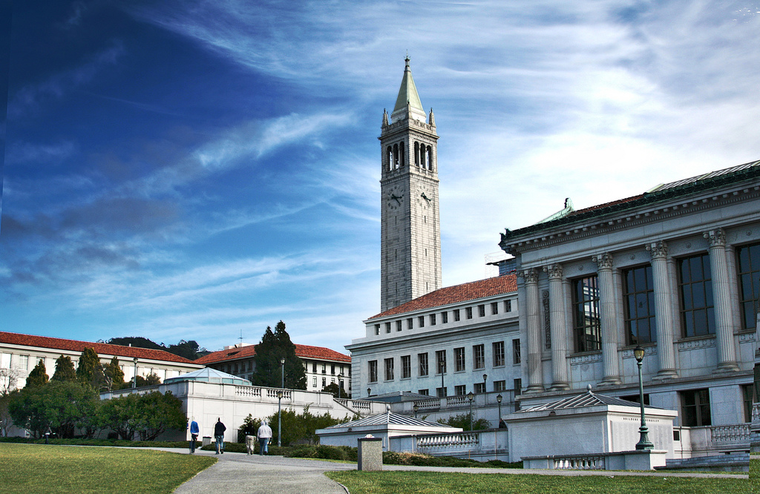

Slide 13
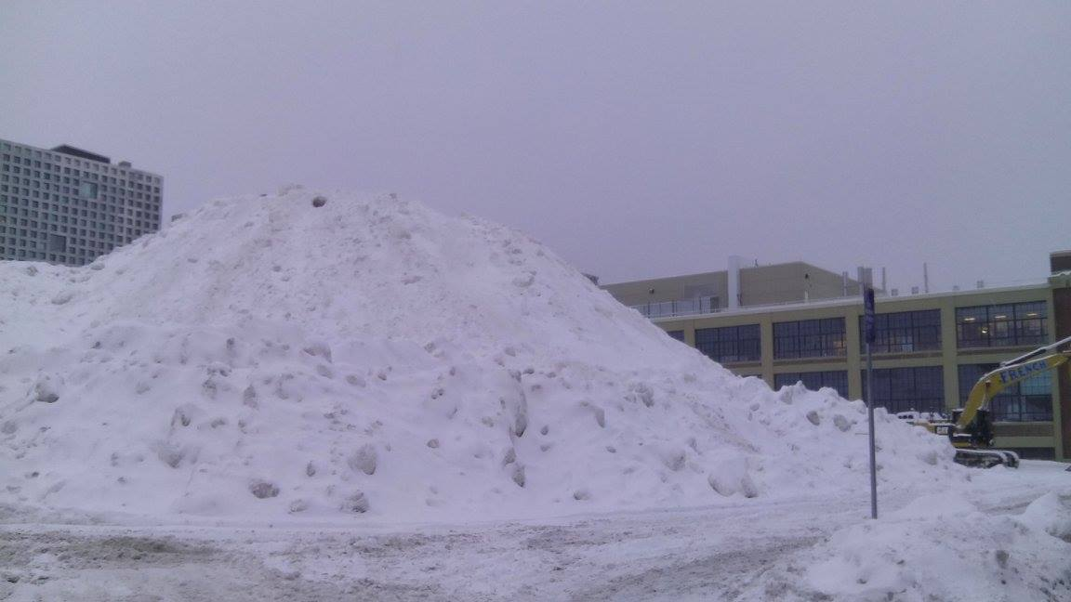

Slide 14
Criteria: Weather

Slide 15


Criteria: Weather

Slide 16
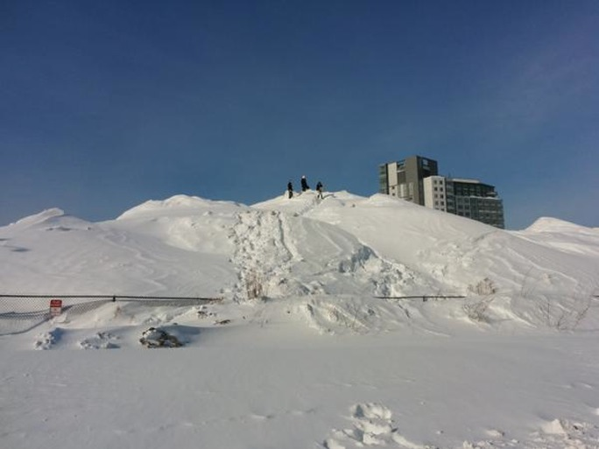
Criteria: Weather

Slide 17
Criteria: Number of Faculty

Slide 18
Criteria: # of Faculty

Slide 19
What is it like to be a monkey?
prospective student

Slide 20
What is it like to be a monkey?
prospective student

Slide 21


What is it like to be a monkey?
prospective student

Slide 22


What is it like to be a monkey?
prospective student

Slide 23
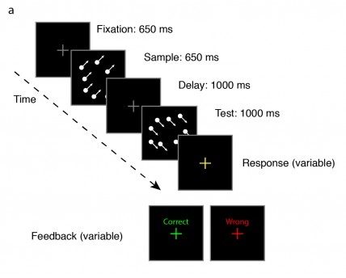

Slide 24
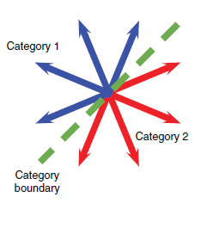

Slide 25
Categorization

Slide 26
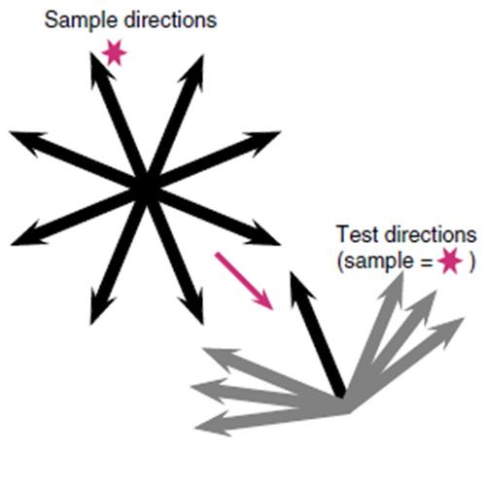
Categorization

Slide 27
Match to
Sample
Categorization

Slide 28
What is it like to be a monkey?

Slide 29
What is it like to be a …
monkey LIP neuron
doing categorization?

Slide 31
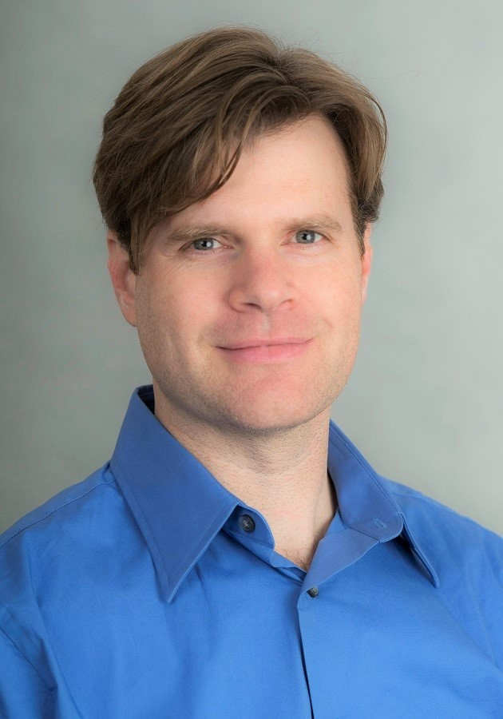
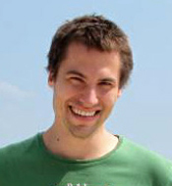
Arup Sarma, Nick Masse, X Wang, David Freedman @ U Chicago
David Freedman
Nick Masse

Slide 34
Sarma et al. 2016

Slide 36
Sarma et al. 2016

Slide 38
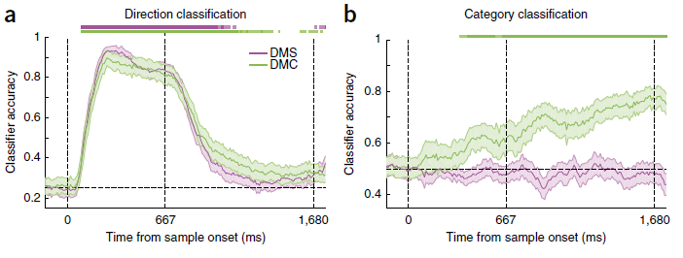

Slide 39
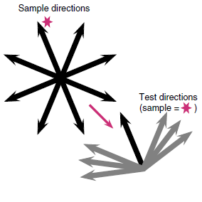
Sarma et al. 2016

Slide 40
What is it like to be a …
monkey LIP neuron
doing sample matching?

Slide 41
Sarma et al. 2016

Slide 42
Sarma et al. 2016

Slide 43
Sarma et al. 2016

Slide 44
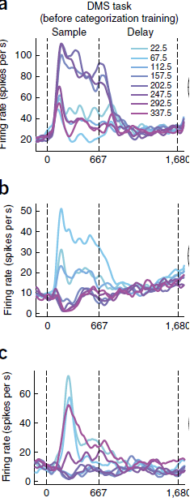

Slide 46

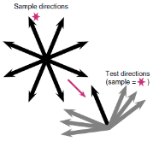
Match to Category
Match to Sample

Slide 47
What is it like to be a
monkey LIP neuron?

Slide 48
What is it like to be a
monkey LIP neuron?

Slide 49
What is it like to be a
monkey LIP neuron?

Slide 50


What is it like to be a
monkey LIP neuron?

Slide 51
What is it like to be a
monkey doing this task?

Slide 52
What is it like to be a
monkey doing this task?
human

Slide 53
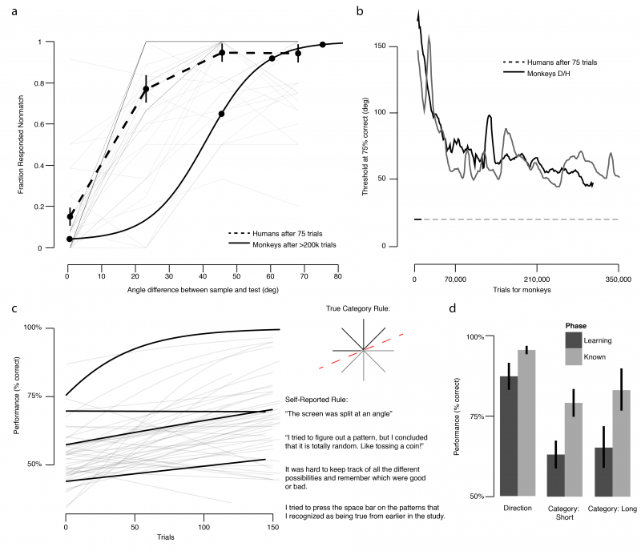

Slide 55
Threshold
~75% correct

Slide 65
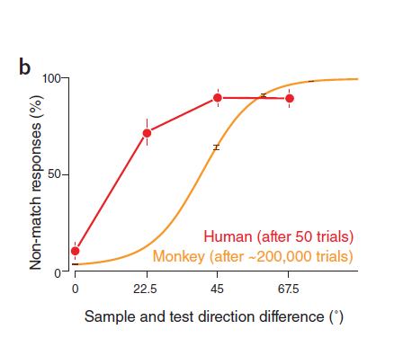
Birman & Gardner, Nat Neuro (2015)

Slide 66
Birman & Gardner, Nat Neuro (2015)

Slide 67
Birman & Gardner, Nat Neuro (2015)

Slide 68
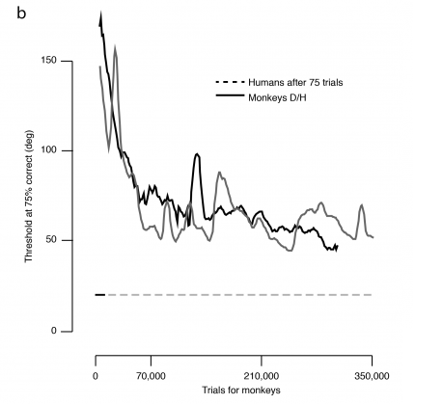

Slide 70
Human Performance (75 trials)

Slide 72
What is it like to be a
monkey doing this task?

Slide 73
What is it like to be a
monkey doing this task?

Slide 74
What is it like to be a
monkey doing this task?

Slide 75
What is it like to be a
monkey doing this task?

Slide 76

Thank you!
Justin Gardner
Freedman Lab @ U Chicago
Nick Masse
David Freedman

